Slide 1
Echinococcus granulosus causes Hydatid disease
Geographical Distribution: cosmopolitan especially in sheep raising countries.

Slide 2
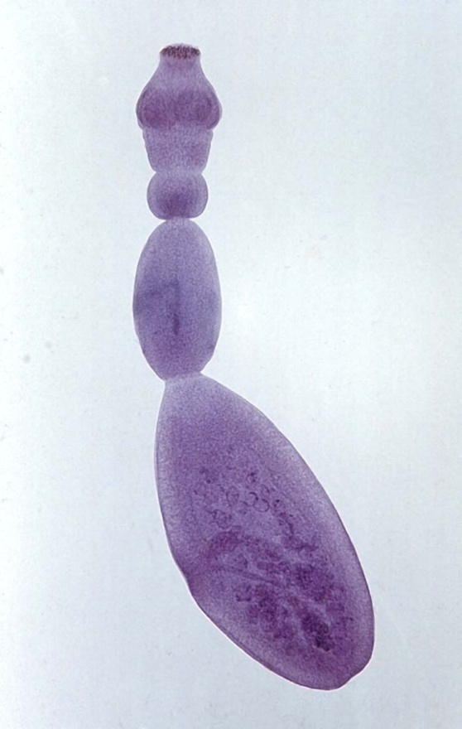
Echinococcus granulosus
A small cestode (3-6 mm. long), formed of 3 segments, immature, mature & gravid.
Scolex: similar to T. solium, globular with 2 circles of dagger-shaped hooks.
Mature segment: longer than broad, similar toTaenia species.
Gravid segment: longer than broad, the gravid uterus gives lateral pouches.
Habitat:
The adult lives in the small intestine of dog & other canines (DH).
Eggs are discharged in the feces, & ingested by sheep, cattle & occasionally man.

Slide 3
Echinococcus granulosus
Man & herbevores (IH): are infected by ingestion of eggs through:
- Hand to mouth, from fur of infected dogs, while playing with
them.
- Food or drink contaminated with feces of infected dogs.
In the intestine of the I.H:
Onchospheres penetrate the intestinal wall, pass by lymphatics or venules to various parts of the body, undergo vesiculation & develop to fluid cysts: hydatid cysts.
Dogs & canines are infected by eating viscera of intermediate hosts, where scolices develop into adults.

Slide 4
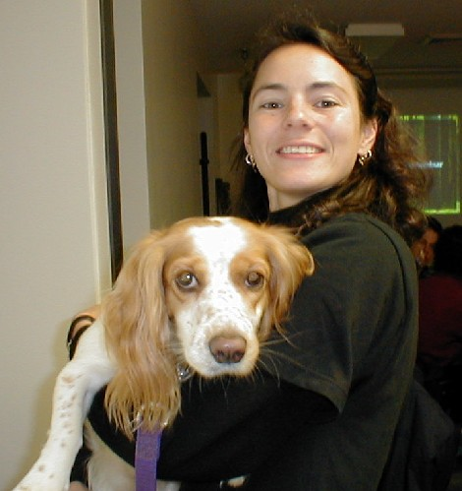
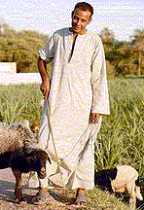
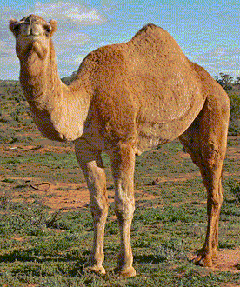
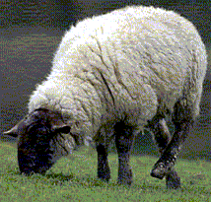
Echinococcus granulosus cause Hydatid disease
Definitive host: Dogs and canines
Habitat: small intestine of dogs
Infective Stage: egg
Similar to Taenia egg
3
1
5
4
2
Intermediate hosts (1-5)
Eggs develop inside Intermediate host into Hydatid cyst

Slide 5
Mode of infection in man
Ingestion of eggs through:
Hand to mouth from fur of dogs while playing with them.
Contaminated food or drink with faeces of infected dogs

Slide 6
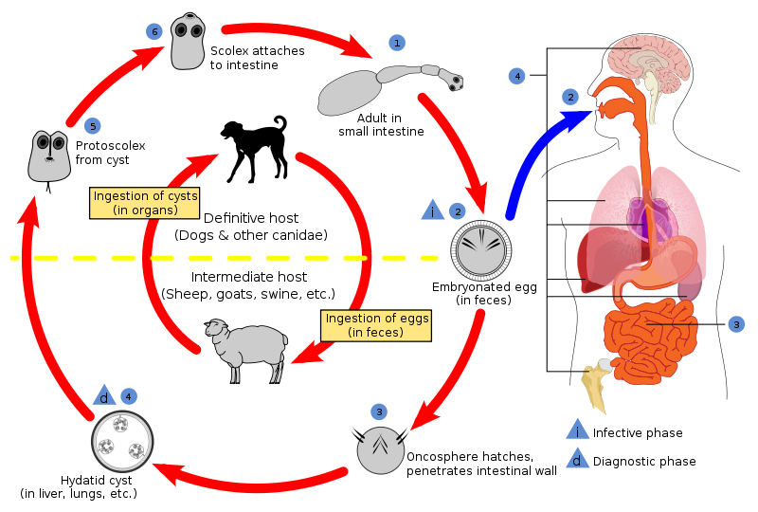
Life Cycle

Slide 7
Morphology of Hydatid Cyst
Fibrous layer
Laminated layer
Germinal layer
Exogenous daughter cyst
Hydatid sand
Daughter cyst
Hydatid fluid
Individual scolices
Brood capsules

Slide 8
Hydatid cyst
Typically unilocular, spherical, filled with fluid.
It takes many years to reach the diameter of 10cm. Or more.
In humans, 80-95% in the liver & lungs, others are found in brain, bones, kidneys.
The cyst wall is differentiated into the following layers from inside to the outside:
- Germinal layer
- Laminated layer
- Fibrous tissue layer
Cyst contains:
Individual scolices: (100- 1000).
Daughter cysts: similar to the mother cyst.
Broad capsules: a number of scolices(up to 15) enclosed in sacs.
(scolices, daughter cysts & broad capsules are either attached to the wall of the mother cyst or may be detached & fall in the fluid as Hydatid sand)

Slide 9
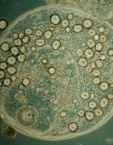
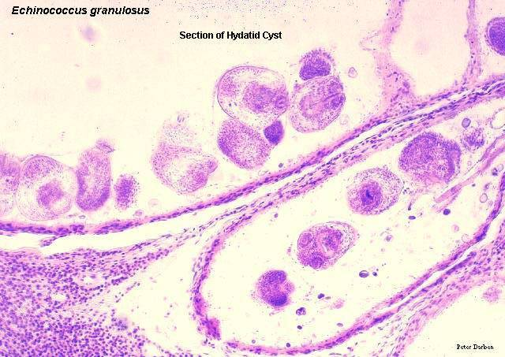
Hydatid cyst (cont.)
Exogenous daughter cyst: herniation of germinal layer to the outside.
Sterile cyst:
germinal layer of the mother & daughter cysts fail to give scolices.
scolex
scolex

Slide 10
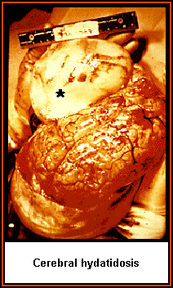
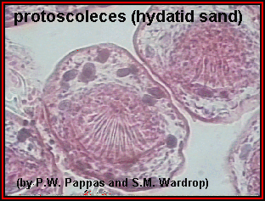

Slide 11
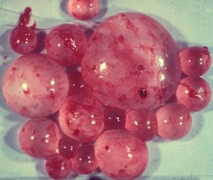
Development of Hydatid Cyst inside human body
1%
Hydatid cysts (from1-10 cm)
Blood vessel
22%
Lymph vessel
Egg
66%
3%
Onchosphere
Lumen of small intestine
2%

Slide 12
Pathogenesis and Clinical Picture
According to the site of cyst:
In the liver: hepatic cyst (about 66%)
1- No symptoms
2- Obstructive jaundice
3- Rupture:
Secondary new cysts
Opens into bile ducts
Allergic manifestations

Slide 13
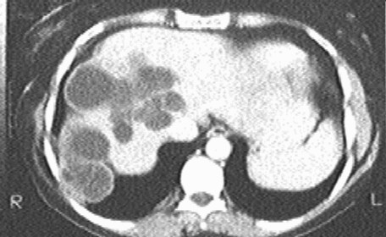
Pathogenesis and Clinical Picture
Secondary new cysts, through seeding with hydatid sand or bits of germinal layer.
Rupture into bile ducts, leading to intermittent jaundice, fever & eosinophilia.
Allergic manifestations up to anaphylactic shock, in case of sudden rupture.
Hydatid cyst in the liver
Multiple Hydatid cyst

Slide 14
Pathogenesis and Clinical Picture
In the lung: Pulmonary cyst (about 22%)
Cyst present within lung tissue cause:
Haemoptysis, transient thoracic pain and shortness of breath.
Cyst transforms into chronic pulmonary abscess:
Sudden attack of cough with sputum containing frothy blood, mucus and hydatid material.

Slide 15
Pathogenesis and Clinical Picture
In the brain: Brain cyst (about 1%)
Increased intracranial tension up to epilepsy
Headache
In the kidney: Renal cyst (about 3%)
Intermittent pain & haematuria
Hydatid sand may be present in urine.

Slide 16
Pathogenesis and Clinical Picture
In the bones: Osseous cyst (about 2%)
Normally hydatid cyst wall is 3 layered
Fibrous layer
Laminated layer
Osseous cyst wall is one layered
Germinal layer
Bone Erosion
Trabeculae Destruction
Spontaneous Fracture

Slide 17
Diagnosis of Hydatid Cyst
Clinically:
- Slowly growing cystic tumor with history of
close contact to dogs.
X-ray imaging: (esp. in the lungs, & calcified cysts):
- Rounded solitary, or multiple, sharply
contoured cysts of 1-15 cm. in diameter.
- Internal daughter cysts, give a car wheel
appearance.
- Thin crescent or ring shape calcifications.
Computerized Tomography (CT) & Ultrasonography:
- Detects uncalcified cysts.
- Of special value in the follow up of treated
cases.

Slide 18
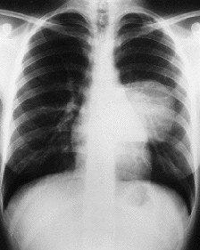
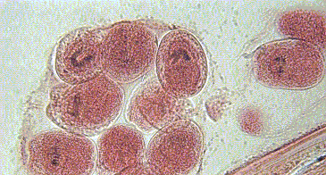
Diagnosis of Hydatid Cyst
2- Computerized tomography & ultrasonography
1- X-ray imaging
3- Finding hydatid material
4- Aspiration cytology
After surgical removal

Slide 19
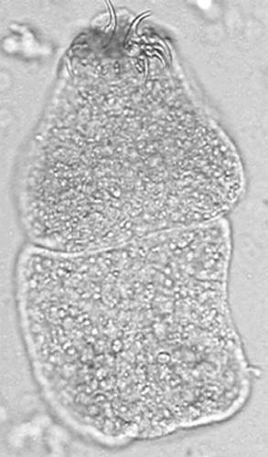
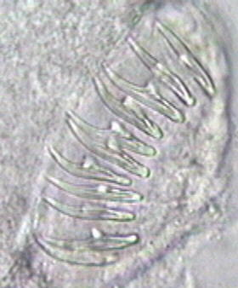
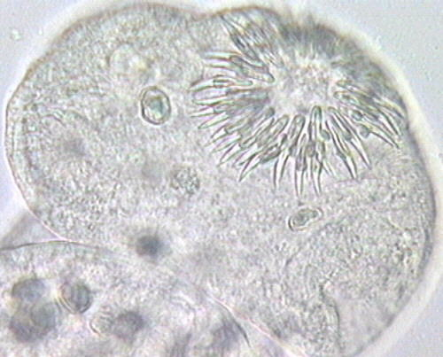
Diagnosis of Hydatid Cyst
Aspiration cytology:
Trichrome stain may be used to show acid-fast hooklets. - Risky & may cause implantation & formation of new cysts. - May cause anaphylactic shock .
Finding hydatid material:
After surgery, in sputum or urine.

Slide 20
Diagnosis
5- Intradermal test of Casoni
May give false positive results in 18%
May give allergic reactions
6- Serological tests
-By IHA to detect anti-hydatid antibodies in patient’s serum
-By ELISA to detect hydatid antigen
-By immunoelectrophoresis to detect serum antibodies against antigen 5
7- Molecular diagnosis
Detection of parasite DNA in patient’s serum

Slide 21
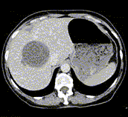
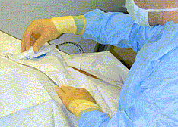
Treatment
1- Surgical removal
2- PAIR Technique
Percutaneous
Aspiration
Injection
Reaspiration
Done under sonographic or CT guidance.
3- Medical treatment
Albendazole (400mg. twice/day for 4 weeks. Repeated up to 12 cycles, each separated by 2 weeks interval.)
Praziquantel (in a dose of 40 mg /kg daily for 15 days)
Aspiration needle

Slide 22
Epidemiology
Infection with hydatid cyst depends on:
Intimate association of humans & infected dogs.
Eggs dispersal & survival as transmission is hand to mouth.
Eggs are obtained from the soil or fur of dogs or through vegetables & water.

Slide 23
Prevention & control
Proper disposal of infected viscera in slaughter house.
Elimination of stray dogs.
Periodic examination & treatment of pet dogs.
Man should avoid dogs & prevent children from playing with them.
Protection of food & drink from being contaminated with dog’s faeces.

Slide 24
Echinococcus multilocularis and Alveolar Hydatid Disease
Geog. Distribution: North America, Siberia & Eskimos
Foxes الثعالب
Wolves الذئاب
Cats
Adult E.multilocularis in small intestine
E.multilocularis eggs are infective stage to man
Eggs form Alveolar cyst in human body (˃90% in liver)

Slide 25
Humans To Be Infected
Humans working in wolves & fox trapping
Humans working in wolves & fox skinning

Slide 26
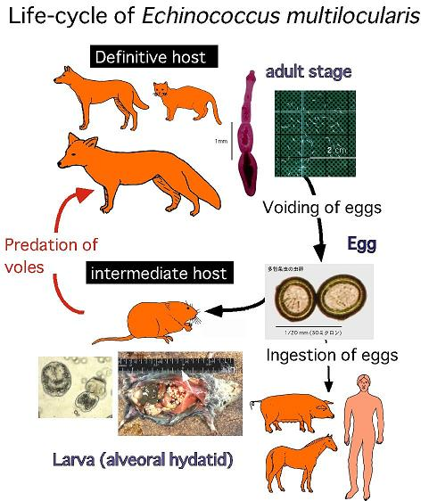
Life cycle

Slide 27
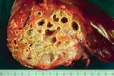
Morphology of Alveolar Cyst
Spongy, gelatinous mass
Formed of small irregular cavities
Cyst has irregular outline & behaves like a malignant tumour
Cyst gives metastasis through blood or lymph
Cyst is usually sterile

Slide 28
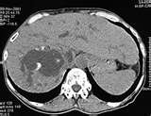
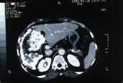
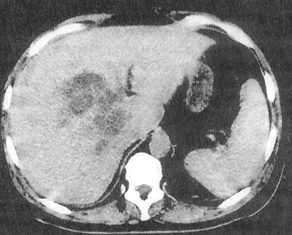
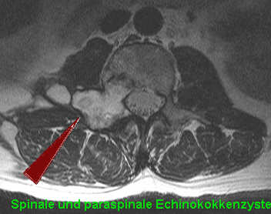
Common in the liver(90- 100%)

Slide 29
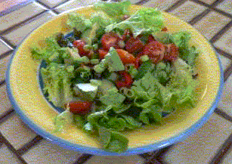
Multiceps multiceps cause Coenurosis
Geog. Distribution: worldwide
Coenurus cyst develops in human brain
Germinal layer
Eggs
Adult in small intestine
Few macroscopic scolices
How man gets infected with M.multiceps

Slide 30
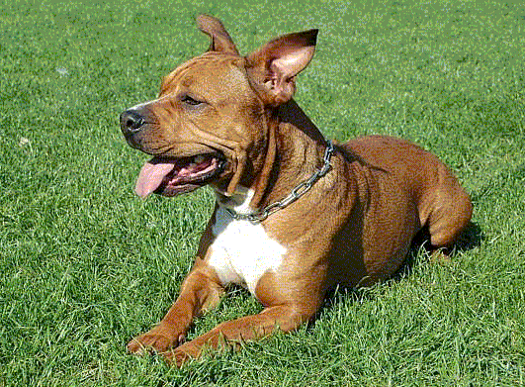
E. granulosus
E.multilocularis
M.multiceps
In Small intestine of dogs
In Small intestine of foxes, wolves
In Small intestine of dogs
Mode of infection
Mode of infection
Mode of infection
Ingestion of egg similar to Taenia egg
Ingestion of egg similar to Taenia egg
Ingestion of egg similar to Taenia egg
Forms Hydatid cyst
Forms Alveolar Hydatid cyst
Forms Coenurus cyst
Favorite site in man is the LIVER (66%)
Favorite site in man is the LIVER (90%)
Favorite site in man is the BRAIN

Slide 31
Hydatid cyst
Coenurus cyst
Alveolar cyst
Unilocular cyst
Multilocular cyst
Fibrous, laminated & germinal layers
Unilocular cyst
Germinal layer
Germinal layer
Septa
Many microscopic scolices (100-1000)
Few macroscopic scolices (30-60)
No scolices (Sterile)

